Slide 2

Angular CLI

Slide 3
Agenda
Introduction
Installation
Angular CLI Commands

Slide 4
Introduction Angular CLI
Angular CLI is a command-line interface tool that can be used to develop and generate Angular projects and helps in maintaining Angular applications. Now, let’s see a few features of Angular CLI.

Slide 5
Features in Angular CLI
Angular CLI helps in producing components, services, and modules with just single-line commands.
It helps in the reduction of the application size of Angular, which offers enhanced development experience.
It also offers a clean coding feature of TypeScript.

Slide 6
Install Visual Studio Code IDE
VS Code is light and easy to setup, it has a great range of built-in code editing, formatting, and refactoring features. It is free to use. It also provides a huge number of extensions that will significantly increase your productivity.
You can download VS Code from here: https://code.visualstudio.com

Slide 7
Install Node.js
Install node.js to run your Angula app. It manages npm dependencies support some browsers when loading particular pages. It provides required libraries to run Angular project. Node.js serves your run-time environment as your localhost.
See how to install node.js: install-nodejs

Slide 8
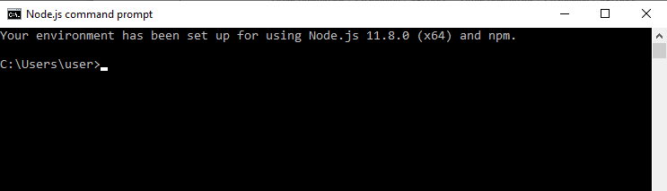
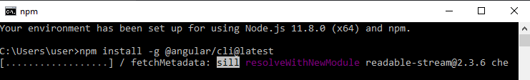
Install Node.js
After the successful installation, we will see command prompt like this:
Use npm to install Angular CLI
Run the Angular CLI command to install Angular CLI
npm install -g @angular/cli

Slide 9
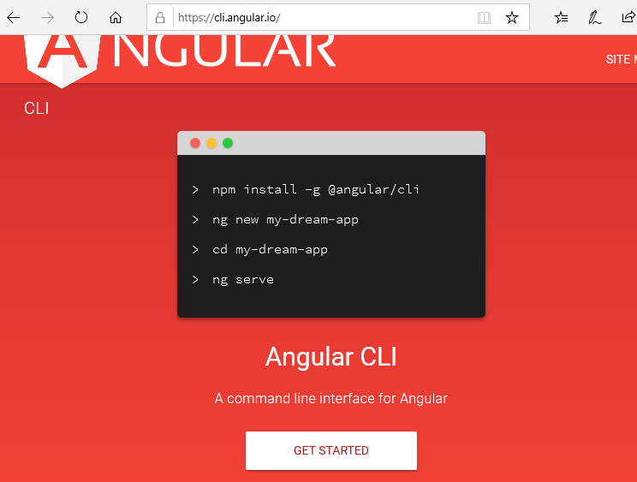
Install Angular CLI
Just go to Angular CLI official website https://cli.angular.io/
You will see the whole cli command to create an Angular app. You need to run the first command to install Angular CLI. These steps are same for Windows and Mac.

Slide 10
Angular CLI Commands
Angular CLI is a command line interface tool which is used to initialize, develop, scaffold, and maintain Angular applications. You can use these command directly on command prompt or indirectly through an interactive UI i.e. Angular Console.
Command | Alias | Description
add |  | It is used to add support for an external library to your project.
build | b | It compiles an Angular app into an output directory named dist/ at the given output path. Must be executed from within a workspace directory.
config |  | It retrieves or sets Angular configuration values in the angular.json file for the workspace.
doc | d | It opens the official Angular documentation (angular.io) in a browser, and searches for a given keyword.
e2e | e | It builds and serves an Angular app, then runs end-to-end tests using Protractor.
generate | g | It generates and/or modifies files based on a schematic.

Slide 11
Angular CLI Commands
Command | Alias | Description
help |  | It provides a list of available commands and their short descriptions.
lint | l | It is used to run linting tools on Angular app code in a given project folder.
new | n | It creates a new workspace and an initial Angular app.
run |  | It runs an Architect target with an optional custom builder configuration defined in your project.
serve | s | It builds and serves your app, rebuilding on file changes.
test | t | It runs unit tests in a project.
update |  | It updates your application and its dependencies. See https://update.angular.io/
version | v | It outputs Angular CLI version.
xi18n |  | It extracts i18n messages from source code.

Slide 12

Ng add Command
Syntax:
Parameter Explanation:
<collection>: It specifies the package which you want to add.
Options | Description
--defaults=true|false: | When true, it disables interactive input prompts for options with a default.
--help=true|false|json|JSON: | It is used to show a help message in the console. Default: false
--interactive=true|false: | When false, it disables interactive input prompts.

Slide 13

Ng build Command
Syntax:
Parameter Explanation:
<project>: It specifies the name of the project to build. It can be an app or a library.
Options | Description
--aot=true|false: | It builds using Ahead of Time compilation. Default: false
--baseHref=baseHref: | It specifies the base url for the application being built.
--buildEventLog=buildEventLog: | (experimental) Output file path for Build Event Protocol events.
--buildOptimizer=true|false: | It enables '@angular-devkit/build-optimizer' optimizations when using the 'aot' option. Default: false
--commonChunk=true|false: | It uses a separate bundle containing code used across multiple bundles. Default: true
--configuration=configuration: | A named build target, as specified in the "configurations" section of angular.json. Each named target is accompanied by a configuration of option defaults for that target.

Slide 14
Ng build Command
Options | Description
--deleteOutputPath=true|false: | It is used to delete the output path before building. Default: true.
--deployUrl=deployUrl: | URL where files will be deployed.
--es5BrowserSupport=true|false: | Enables conditionally loaded ES2015 polyfills. Default: false.
--extractCss=true|false: | It is used to extract css from global styles into css files instead of js ones. Default: false
--extractLicenses=true|false: | It is used to extract all licenses in a separate file. Default: false
--forkTypeChecker=true|false: | It is used to run the TypeScript type checker in a forked process. Default: true
--help=true|false|json|JSON: | It is used to show a help message for this command in the console. Default: false
--i18nFile=i18nFile: | Localization file to use for i18n.
--i18nFormat=i18nFormat: | Format of the localization file specified with --i18n-file.
--i18nLocale=i18nLocale: | Locale to use for i18n.
--index=index: | The name of the index HTML file.

Slide 15
Ng build Command
Options | Description
--lazyModules: | List of additional NgModule files that will be lazy loaded. Lazy router modules will be discovered automatically.
--main=main: | The full path for the main entry point to the app, relative to the current workspace.
--namedChunks=true|false: | Use file name for lazy loaded chunk Default: true
--ngswConfigPath=ngswConfigPath: | Path to ngsw-config.json.
--optimization=true|false: | Enables optimization of the build output.
--outputHashing= none|all|media|bundles: | Define the output filename cache-busting hashing mode.
--outputPath=outputPath: | The full path for the new output directory, relative to the current workspace.
--poll: | Enable and define the file watching poll time period in milliseconds.
--polyfills=polyfills: | The full path for the polyfills file, relative to the current workspace.
--preserveSymlinks=true|false: | Do not use the real path when resolving modules.

Slide 16
Ng build Command
Options | Description
--prod=true|false: | When true, sets the build configuration to the production target. All builds make use of bundling and limited tree-shaking. A production build also runs limited dead code elimination.
--profile=true|false: | Output profile events for Chrome profiler.
--progress=true|false: | Log progress to the console while building.
--resourcesOutputPath= resourcesOutputPath: | The path where style resources will be placed, relative to outputPath.
--serviceWorker=true|false: | Generates a service worker config for production builds. Default: false
--showCircularDependencies=true|false: | Show circular dependency warnings on builds. Default: true
--sourceMap=true|false: | It is used to show Output sourcemaps.
--subresourceIntegrity=true|false: | It enables the use of subresource integrity validation.
--tsConfig=tsConfig: | The full path for the TypeScript configuration file, relative to the current workspace.

Slide 17
Ng build Command
Options | Description
--vendorChunk=true|false: | It uses a separate bundle containing only vendor libraries.
--verbose=true|false: | It adds more details to output logging.
--watch=true|false: | It runs build when files change.

Slide 18

Ng config Command
Syntax:
Parameter Explanation:
<jsonPath>: The configuration key to set or query, in JSON path format. For example: "a[3].foo.bar[2]". If no new value is provided, returns the current value of this key.
<value>: If provided, a new value for the given configuration key.
Options | Description
--global=true|false: | When true, it accesses the global configuration in the caller's home directory.
--help= true|false|json|JSON: | It is used to show a help message for this command in the console.

Slide 19

Ng doc Command
Syntax:
Parameter Explanation:
<keyword>: It is used to specify the keyword to search for, as provided in the search bar in angular.io.
Options | Description
--help=true|false|json|JSON: | It is used to show a help message for this command in the console.
--search=true|false: | When true, it searches all of angular.io. Otherwise, searches only API reference documentation.

Slide 20

Ng e2e Command
Syntax:
It must be executed from within a workspace directory. When you don't specify the project name, it executes for all projects.
Parameter Explanation:
<project>: It specifies the name of the project you want to build. It can be an app or a library.
Options | Description
--baseUrl=baseUrl: | It specifies the base URL for protractor to connect to.
--configuration=configuration: | It is used to specify named build target, as specified in the "configurations" section of angular.json. Each named target is accompanied by a configuration of option defaults for that target.
--devServerTarget=devServerTarget: | It specifies dev server target to run tests against.

Slide 21
Ng e2e Command
Options | Description
--devServerTarget=devServerTarget: | It specifies dev server target to run tests against.
--elementExplorer=true|false: | It starts Protractor's Element Explorer for debugging.
--help= true|false|json|JSON: | It shows a help message for this command in the console.
--host=host: | Host to listen on.
--port: | It specifies the port to serve the application.
--protractorConfig= protractorConfig: | It specifies the name of the Protractor configuration file.
--specs: | It overrides specs in the protractor config.
--suite=suite: | It overrides suite in the protractor config.
--webdriverUpdate=true|false: | It is used to update webdriver.
--prod=true|false: | When true, it sets the build configuration to the production target. All builds make use of bundling and limited tree-shaking. A production build also runs limited dead code elimination.

Slide 22

Ng generate command
Syntax:
Parameter Explanation:
<schematic >: It specifies the schematic or collection:schematic which you want to generate. It can take one of the following sub-commands.
appShell
application
class
component
directive
enum
guard
interface
library
module
pipe
service
serviceWorker
universal

Slide 23



Ng generate Command
Schematic Command Explanation
appShell: It is used to generate an app shell for running a server-side version of an app.
Syntax:
Application: It is used to create a new basic app definition in the "projects" subfolder of the workspace.
Syntax:
Class: It is used to create a new generic class definition in the given or default project.
Syntax:

Slide 24




Ng generate command
Component: It is used to create a new generic component definition in the given or default project.
Syntax:
Enum: It is used to create a new, generic enum definition for the given or default project.
Syntax:
Guard: It is used to generate a new, generic route guard definition in the given or default project.
Syntax:
Interface: It is used to create a new generic interface definition in the given or default project.
Syntax:

Slide 25




Ng generate Command
Library: It is used to create a new generic library project in the current workspace.
Syntax:
Module: It is used to create a new generic NgModule definition in the given or default project.
Syntax:
Pipe: It is used to create a new generic pipe definition in the given or default project.
Syntax:
Service: It is used to create a new, generic service definition in the given or default project.
Syntax:

Slide 26

Ng generate Command
Universal:This command is used to pass this schematic to the "run" command to set up server-side rendering for an app.
Syntax:
Options | Description
--defaults=true|false: | When true, it disables interactive input prompts for options with a default.
--dryRun=true|false: | When true, it runs through and reports activity without writing out results.
--force=true|false: | When true, it forces overwriting of existing files.
--help=true|false|json|JSON: | It is used to show a help message in the console.
--interactive=true|false: | When false, it disables interactive input prompts.

Slide 27
THANK YOU

